Slide 1
Stable Coins
Daniele Marazzina

Slide 2

A stablecoin is a new class of cryptocurrencies that attempts to offer price stability and are backed by a reserve asset.
Stablecoins have gained traction as they attempt to offer the best of both world’s—the instant processing and security or privacy of payments of cryptocurrencies, and the volatility-free stable valuations of fiat currencies.
Stablecoins are cryptocurrencies that attempt to peg their market value to some external reference.
Stablecoins may be pegged to a currency like the U.S. dollar or to a commodity's price such as gold.
Stablecoins achieve their price stability via collateralization (backing) or through algorithmic mechanisms of buying and selling the reference asset or its derivatives.

Slide 3
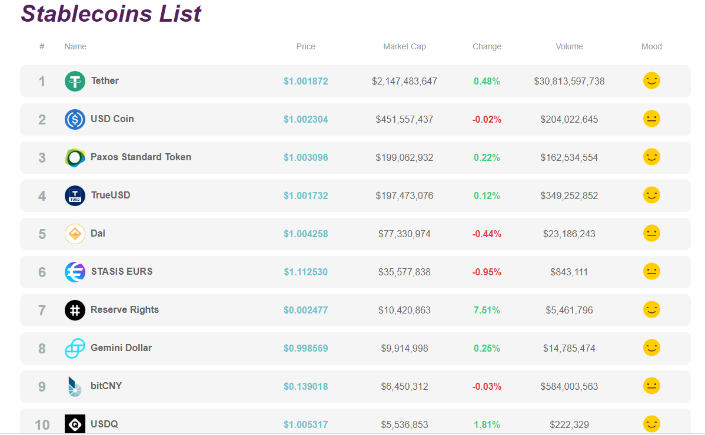
2019

Slide 4
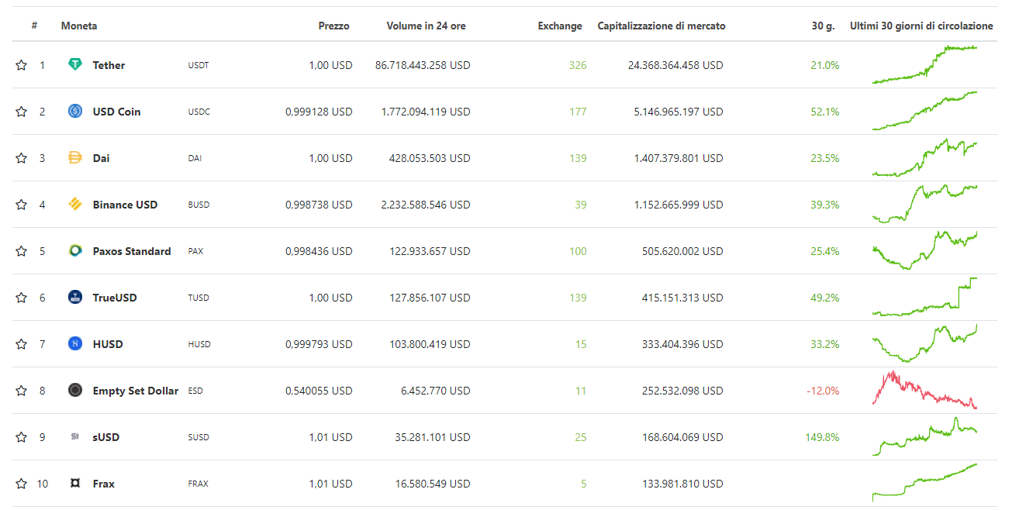
2020

Slide 5
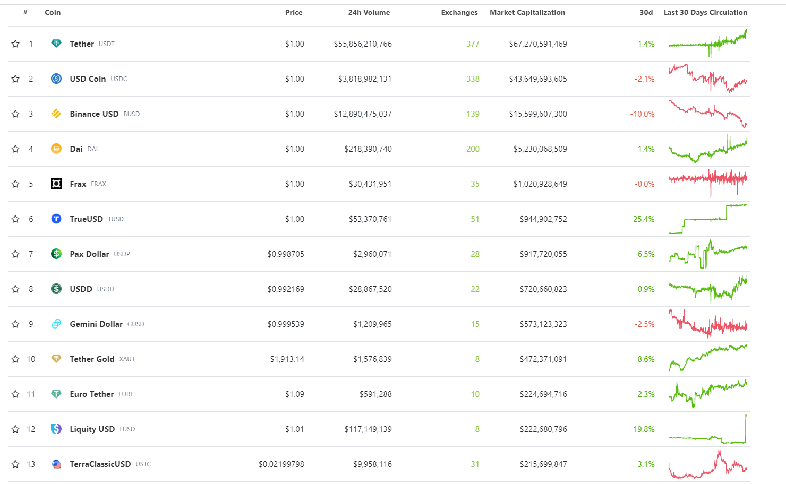
2023

Slide 6
The Reserve protocol comprises two tokens: the Reserve token (RSV - a decentralized stablecoin) and the Reserve Rights token (RSR - a cryptocurrency used to facilitate the stability of the Reserve token and confers the cryptographic right to purchase excess Reserve tokens as the network grows).
Pegged to the Chinese Yuan
1 Yuan = $ 0.1443 at this moment

Slide 7
Gold-Backed Stablecoins
Usually one token of stablecoin equals one gram of the gold. Since they’re tied to the gold, this stablecoin’s price can’t fall below the current price of the gold. A third party holds the gold in reserve.
https://novemgold.com/
https://digix.global/
https://www.goldmint.io/
https://gold.tether.to/

Slide 8
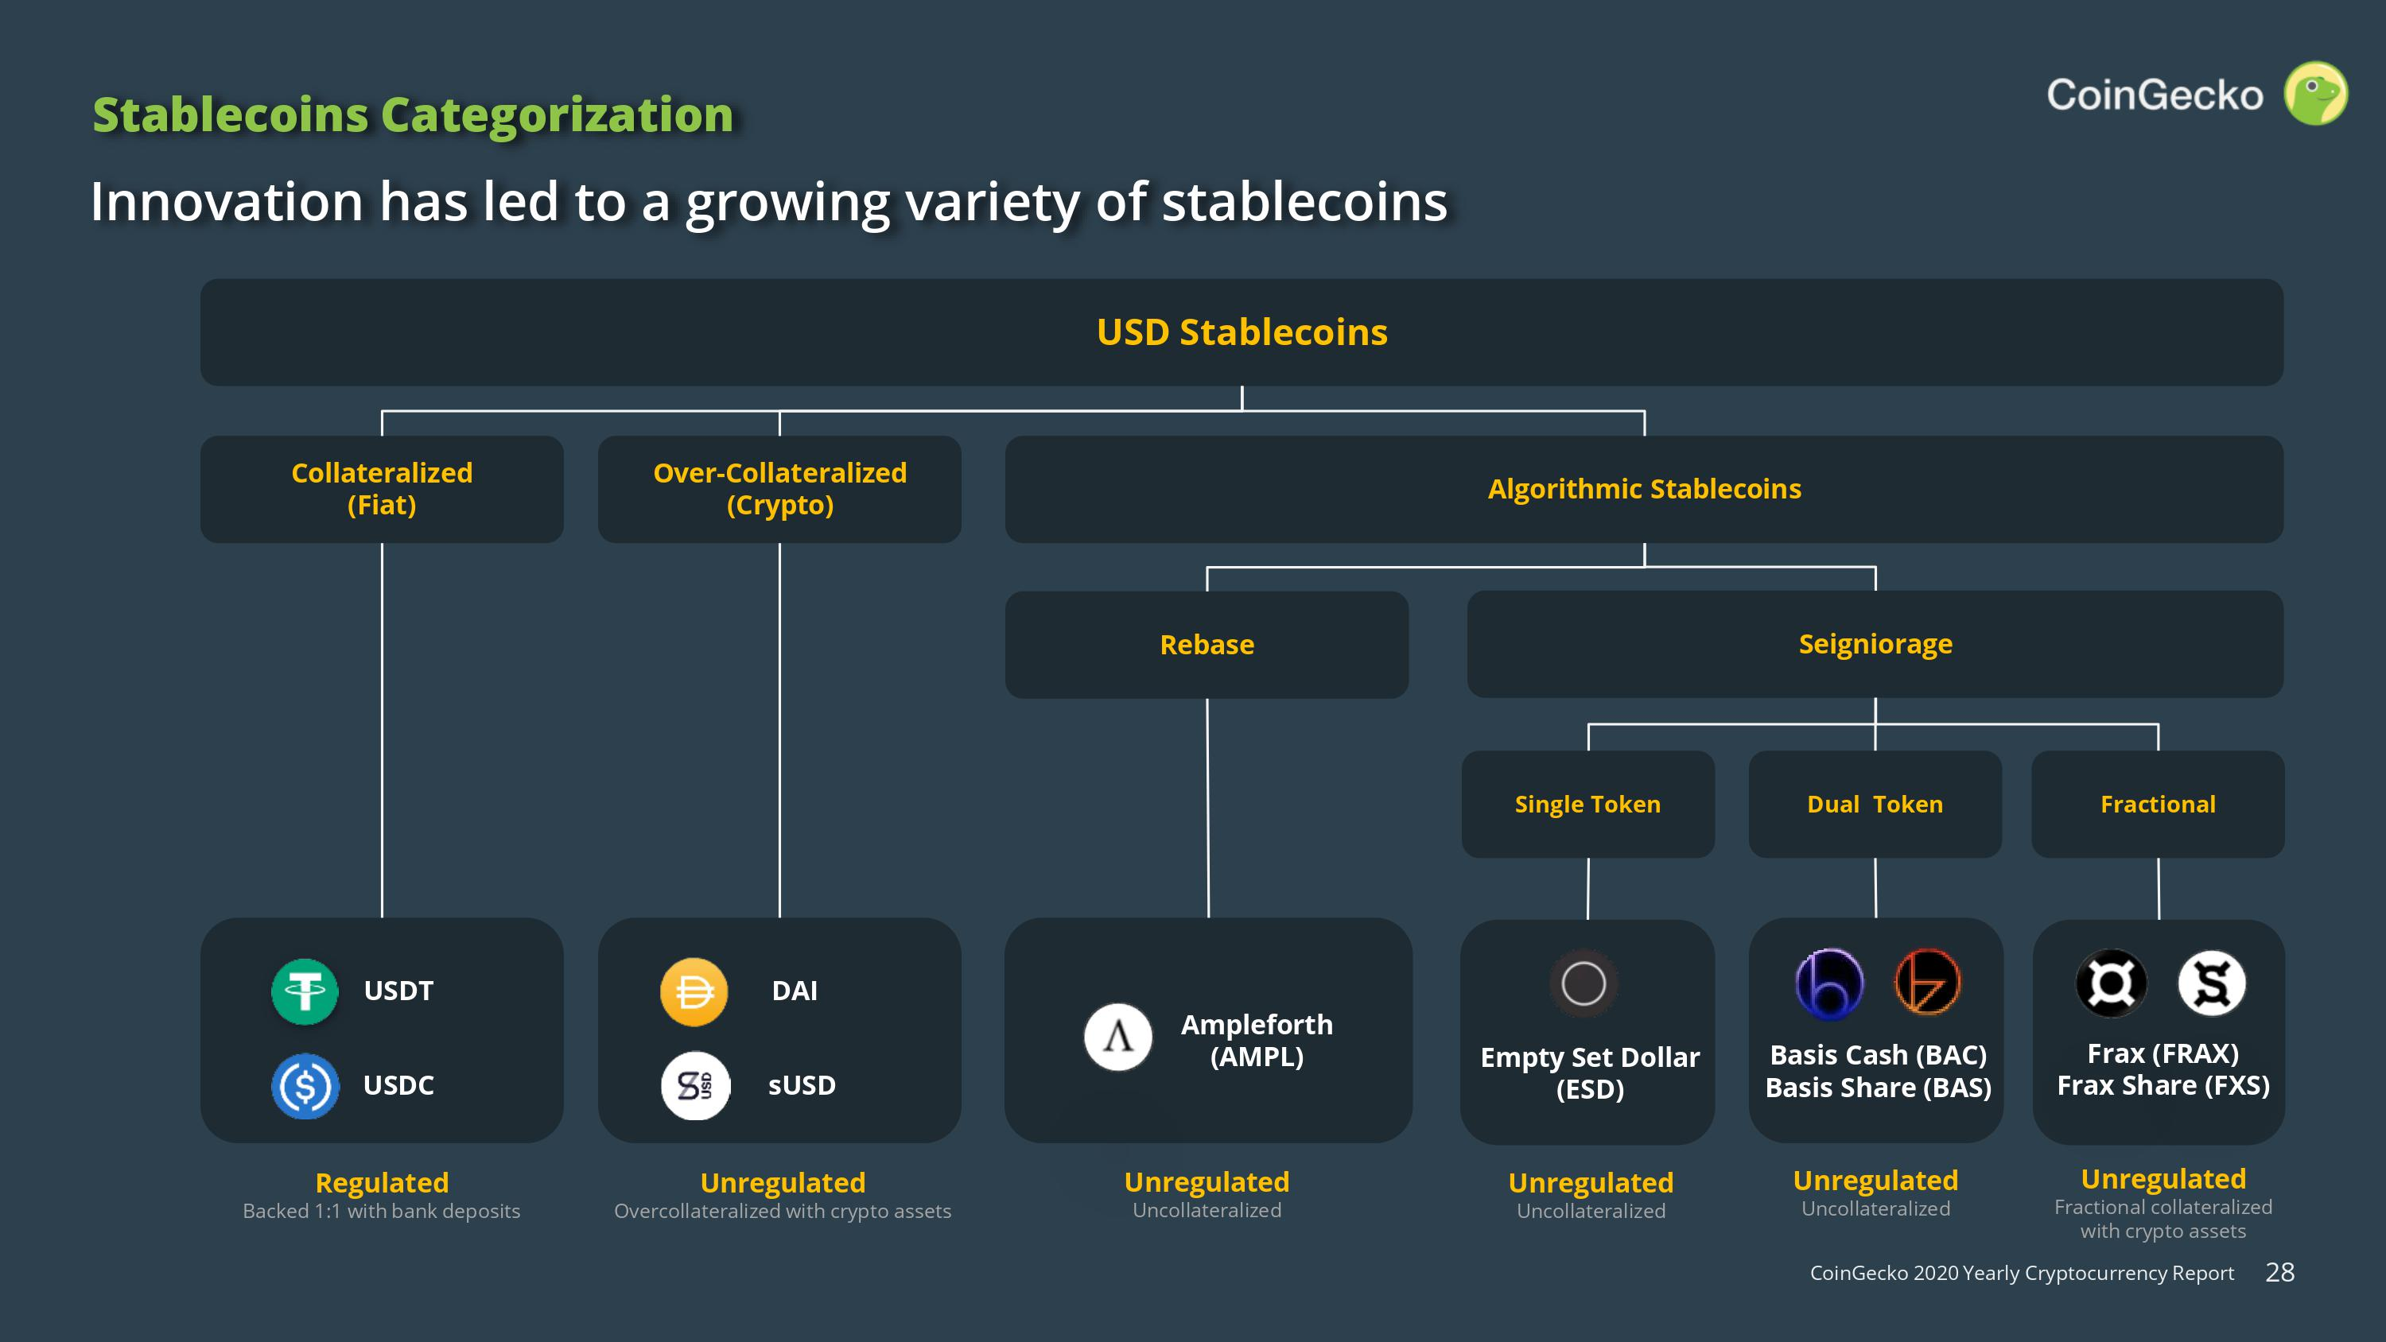

Slide 9
TETHER
https://tether.to/

Slide 10
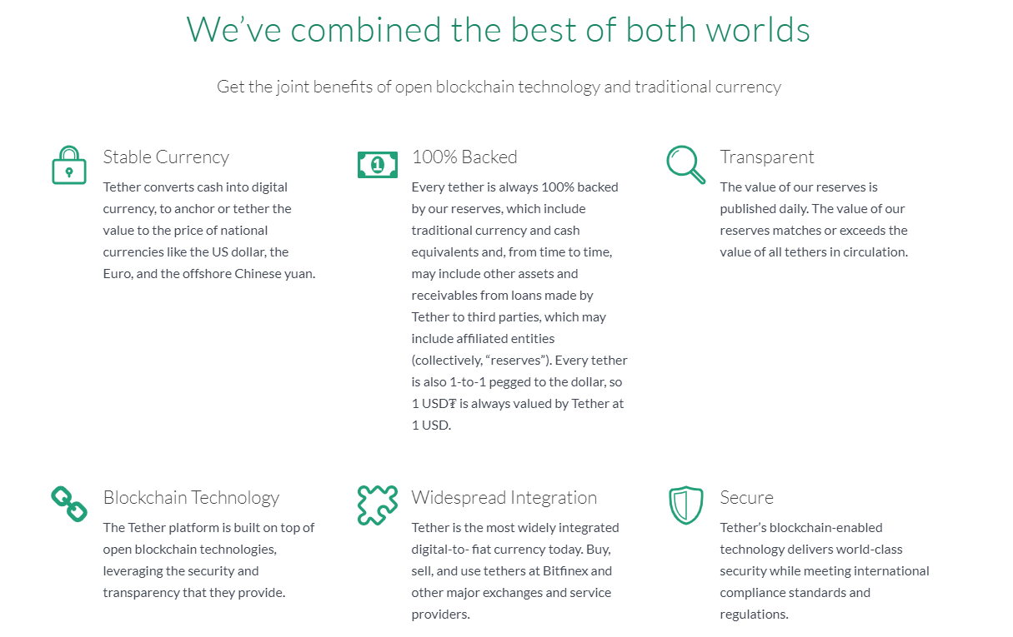

Slide 11
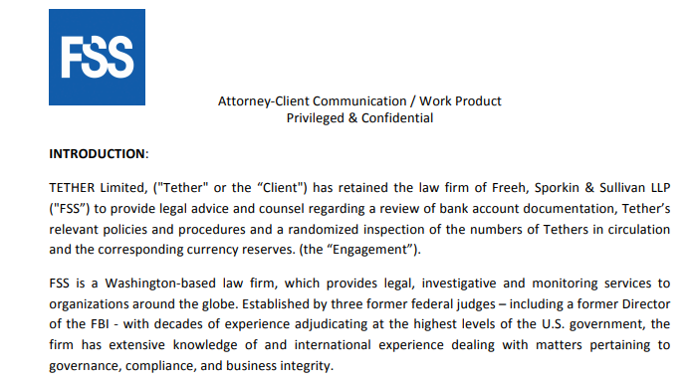
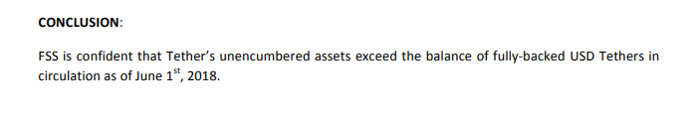
Proof of funds: https://tether.to/wp-content/uploads/2018/06/FSS1JUN18-Account-Snapshot-Statement-final-15JUN18.pdf

Slide 12
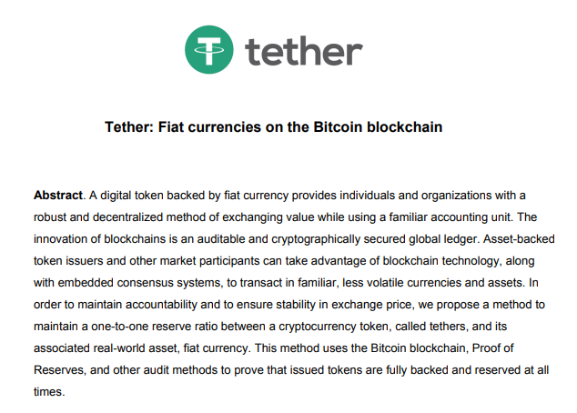
https://tether.to/en/whitepaper/

Slide 13
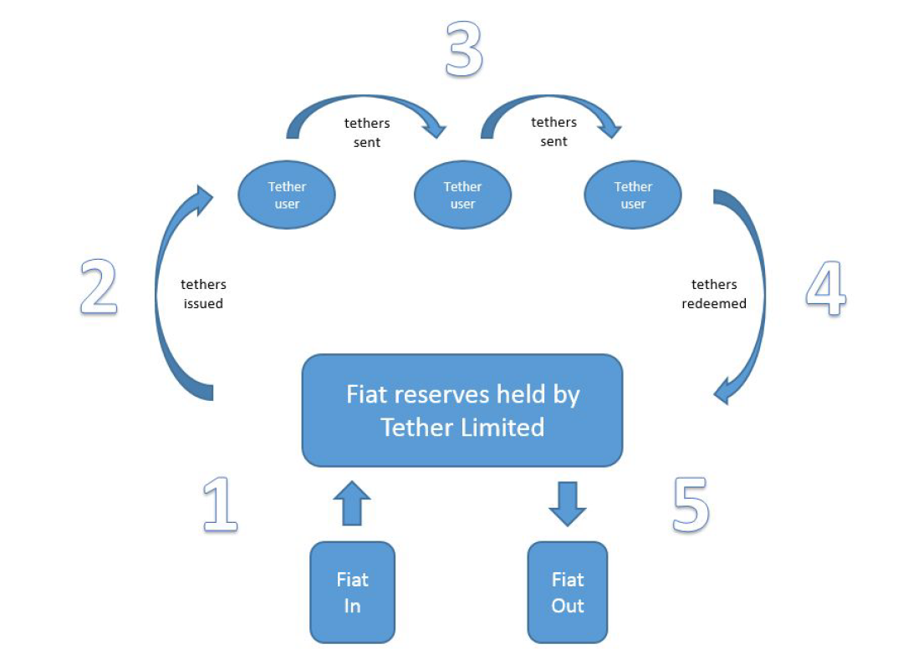
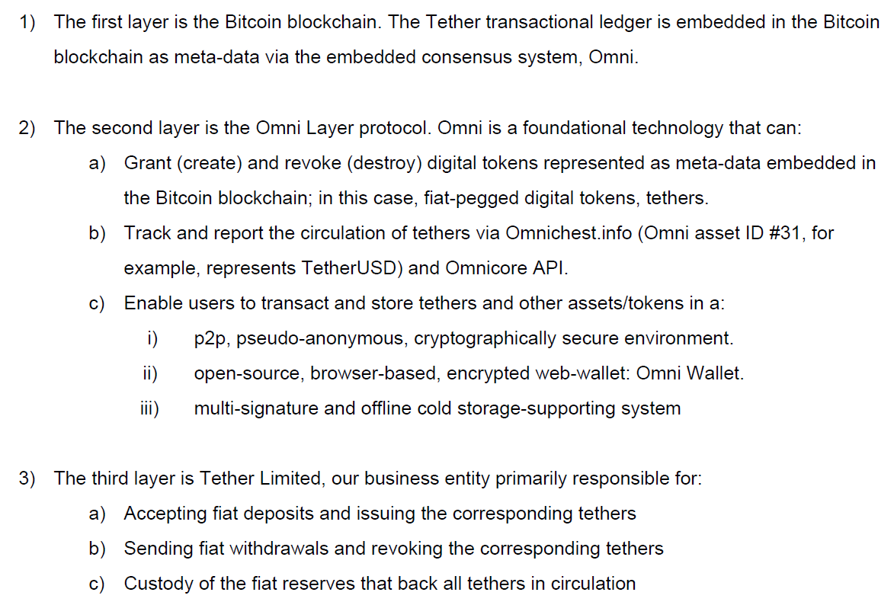

Slide 14
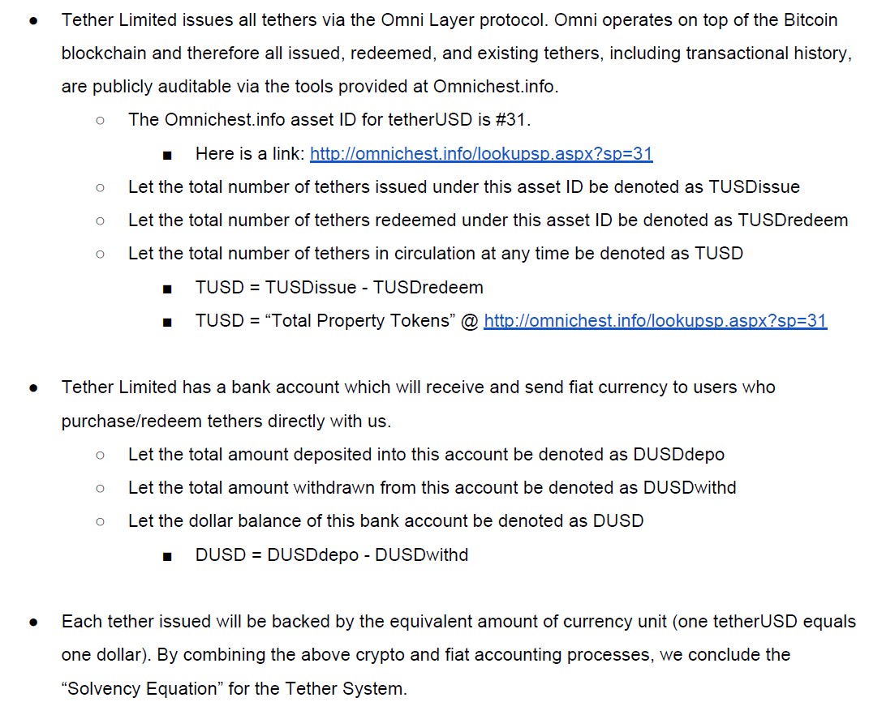

Slide 15
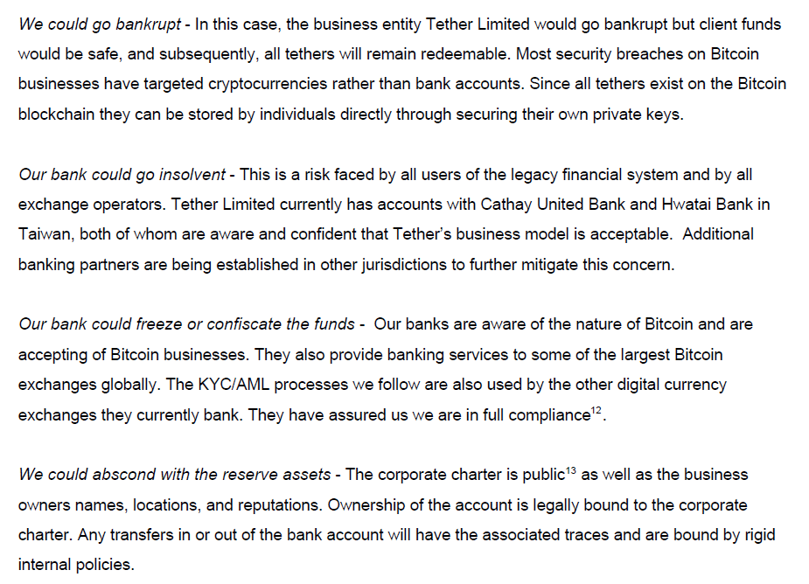

Slide 16
The reality
Beginning with a whitepaper published online in January 2012, J.R. Willett described the possibility of building new currencies on top of the Bitcoin Protocol.
The precursor to Tether, originally named "Realcoin", was announced in July 2014. The first tokens were issued on 6 October 2014, on the Bitcoin blockchain.
On 20 November 2014, Tether CEO Reeve Collins announced the project was being renamed to "Tether“.
In January 2015, the cryptocurrency exchange Bitfinex enabled trading of Tether on their platform.
In early 2018 Tether accounted for about 10% of the trading volume of bitcoin, but during the summer of 2018 it accounted for up to 80% of bitcoin volume. Research suggests that a price manipulation scheme involving tether accounted for about half of the price increase in bitcoin in late 2017.
It formerly claimed that each token was backed by one United States dollar, but on 14 March 2019 changed the backing to include loans to affiliate companies
On 30 April 2019 Tether Limited's lawyer claimed that each tether was backed by only $0.74 in cash and cash equivalent.

Slide 17
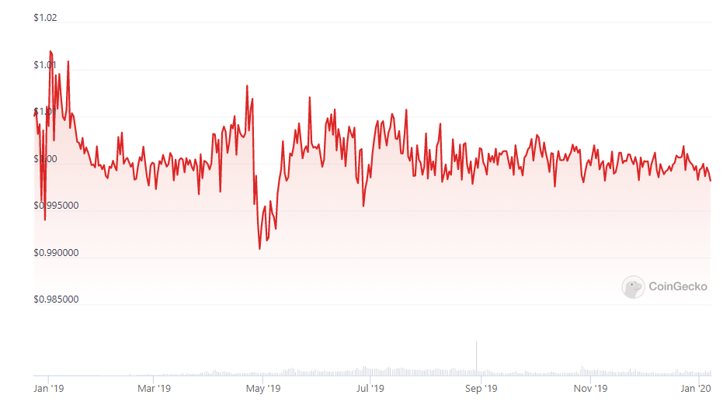
Reserves
https://tether.to/en/transparency/#reports

Slide 18
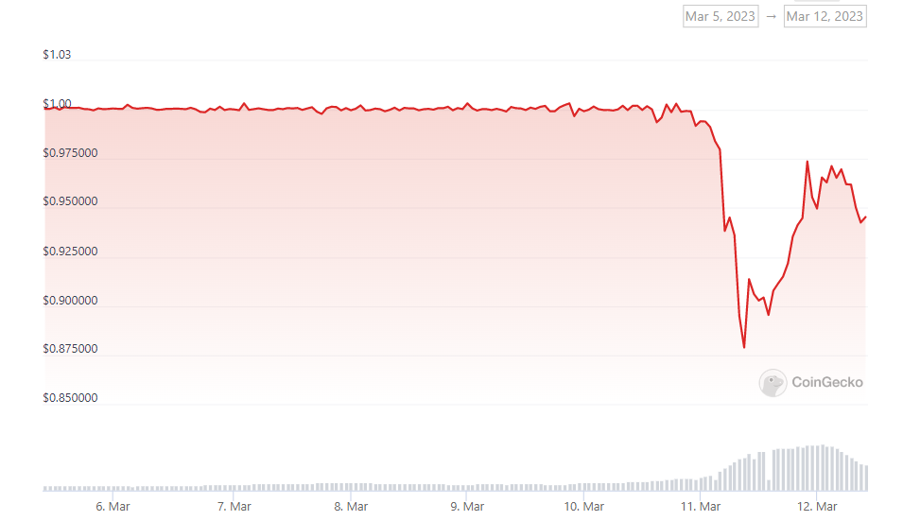
USDC (fiat reserved stablecoin)
Beginning of March 2023: «Silicon Valley Bank (SIVB), another crypto-friendly bank, comes under pressure.»
Circle said in a tweet on Friday (March, 10) it has $3.3 billion of its $40 billion of USDC reserves at Silicon Valley Bank. Circle, the firm behind USDC, assured investors it would honor the peg despite exposure to failed Silicon Valley Bank.

Slide 19
MAKER DAO
https://makerdao.com/

Slide 20
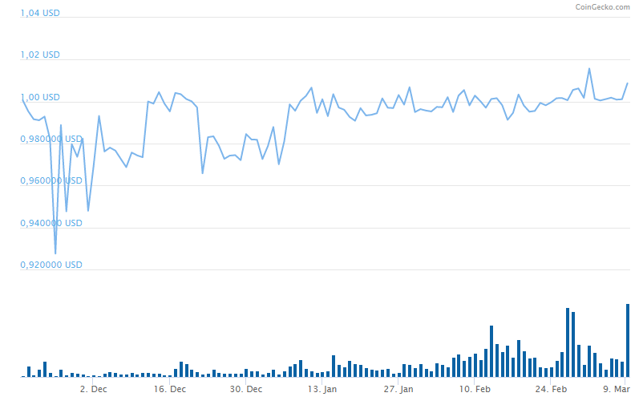
MakerDAO is a protocol behind the stable coin DAI — a cryptocurrency that maintains a 1:1 peg to the USD.

Slide 21
Dai (Maker’s stablecoin) is backed by collateral (ether to be specific).
Let’s say you’re an ether holder and you would like to create Dai.
Your first move would be to send your ether to a “collateralized debt position” (CDP). A CDP is a type of software that runs on the blockchain, in this case the ethereum blockchain, and lives within the Maker ecosystem.
Once your ether is in the CDP smart contract, you are able to create Dai. The amount of Dai you can create is relative to how much ether you have put into the CDP. This ratio is fixed, but can be changed over time. The amount of Dai I can create relative to the ether I put in is called the collateralization ratio.
Assume 1 ether = $100 and collateralization ratio is 1.5. If I send 1 ether into the CDP smart contract, then I am now able to create 66 Dai, i.e. 100/1.5.

Slide 22
what happens when ether goes up
The system becomes over collateralized and Dai becomes stronger.
Maker has mechanisms that incentivize users to create more Dai if the price of Dai should trade above one dollar
what happens when ether goes down
If ether goes down, now that can cause problems.
If the value of ether held as collateral is worth less than the amount of Dai it’s supposed to be backing, then Dai would not be worth one dollar and the system could collapse.
Maker combats this by liquidating CDPs and auctioning off the ether inside before the value of the ether is less than the amount of Dai it is backing.
Basically, if the price feed into the CDP indicates that the value of ether has gone below a certain threshold, the liquidation ratio (let’s use 125% of created Dai), then the CDP is “liquidated” and the ether inside the CDP is auctioned off for Dai until there is enough Dai to pay back what was extracted from the CDP.

Slide 23
Volatility cannot be destroyed, it can only be transferred. If we have a stable token like Dai that has been stripped of its volatility, where did it go? In the Maker system, volatility is transferred entirely to the holder of the CDP. Using our prior example, should I withdraw 66 Dai from a CDP containing one ether, I will only own that one ether if its price is above the liquidation ratio. Dai is effectively a loan on my ether.
This leads us to the interesting consequence: I can take the Dai that I borrowed and use it to buy more ether. By doing this, I am basically buying ether on margin. That’s right, completely decentralized leverage!
Source: https://medium.com/cryptolinks/maker-for-dummies-a-plain-english-explanation-of-the-dai-stablecoin-e4481d79b90

Slide 24
Two simple examples assuming the price of Ether is $150 and you deposit 1 ETH at this price. Liquidation ratio is 1.5.
You decide to take out 50 DAI which means your CDP is collateralised 300% (collateralization ratio=3). As long as the price of Ether doesn’t drop below $75 (50 * 1.5) your position will be safe. After one year, you decide to pay back the 50 DAI and retrieve your Ether locked up. Upon closing the position or other interactions with your CDP, you’ll pay the annual stability fee (set at 3.5% as of March 2019).
You decide to take out 95 DAI which means your CDP is collateralised at just 150.26% (collateralization ratio=1.5026, very close to liquidation ratio). The price of Ether drops to $100 which means your CDP is under-collateralized: $95*1.5 = $142.50 > $100. A 3rd party will realise that you don’t have enough collateral and liquidate your CDP on your behalf. This results in your position being liquidated by 3rd parties with a penalty. These 3rd parties have various ways to profit from your position being liquidated.

Slide 25
Inside the MakerDAO ecosystem, their native MKR token allows token holders to influence certain aspects of the protocol such as:
What should the be the annual borrowing fee be (stability fee)?
How much collateral should be backing each CDP (liquidation ratio)?
Shutting down the protocol in the case of a flash crash of the price of Ether or any other unforeseen situation (emergency shutdown)?
MakerDAO is like a credit facility that issues loans with a certain interest rate. If the interest rate (stability fee) is low, people are encouraged to borrow more (lock up more ETH). If the interest rate is high, the cost of capital is high making it less attractive to borrow (close out CDPs).
Recently, DAI has been consistently been trading on exchanges below $1. A big reason for this is because there is significant pressure from DAI holders to sell.
DAI can only be generated via the opening of CDPs. To bring the peg back to its correct target price, MKR holders voted to increase the stability fee from 1% to 3.5% in hopes that it reduces the incentive to open CDP (and close existing CDPs) to increase the buy pressure.
In the future the Maker team plans to introduce the Dai Savings Rate, which will allow DAI holders to lock up their DAI and earn interest. The interest paid to holders is financed from the stability fee.
Source: https://hackernoon.com/whats-makerdao-and-what-s-going-on-with-it-explained-with-pictures-f7ebf774e9c2

Slide 26
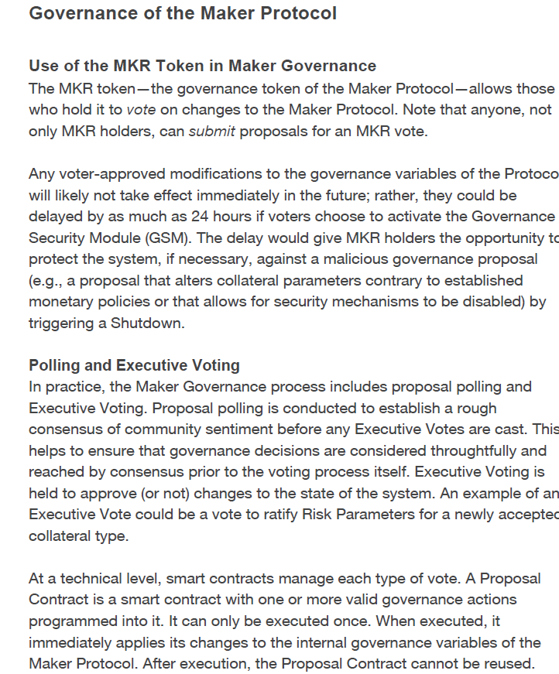
Source: whitepaper

Slide 27
Algorithmic stable coins

Slide 28
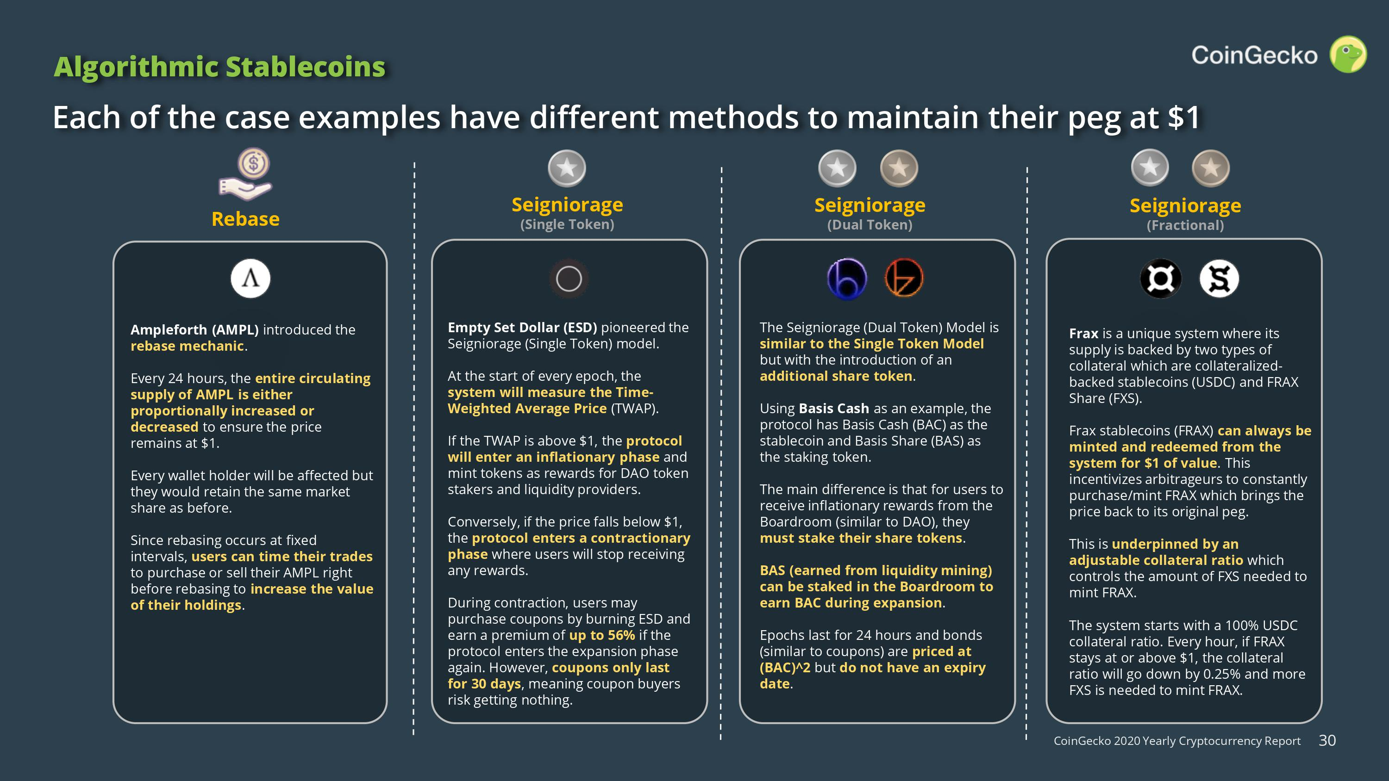

Slide 29
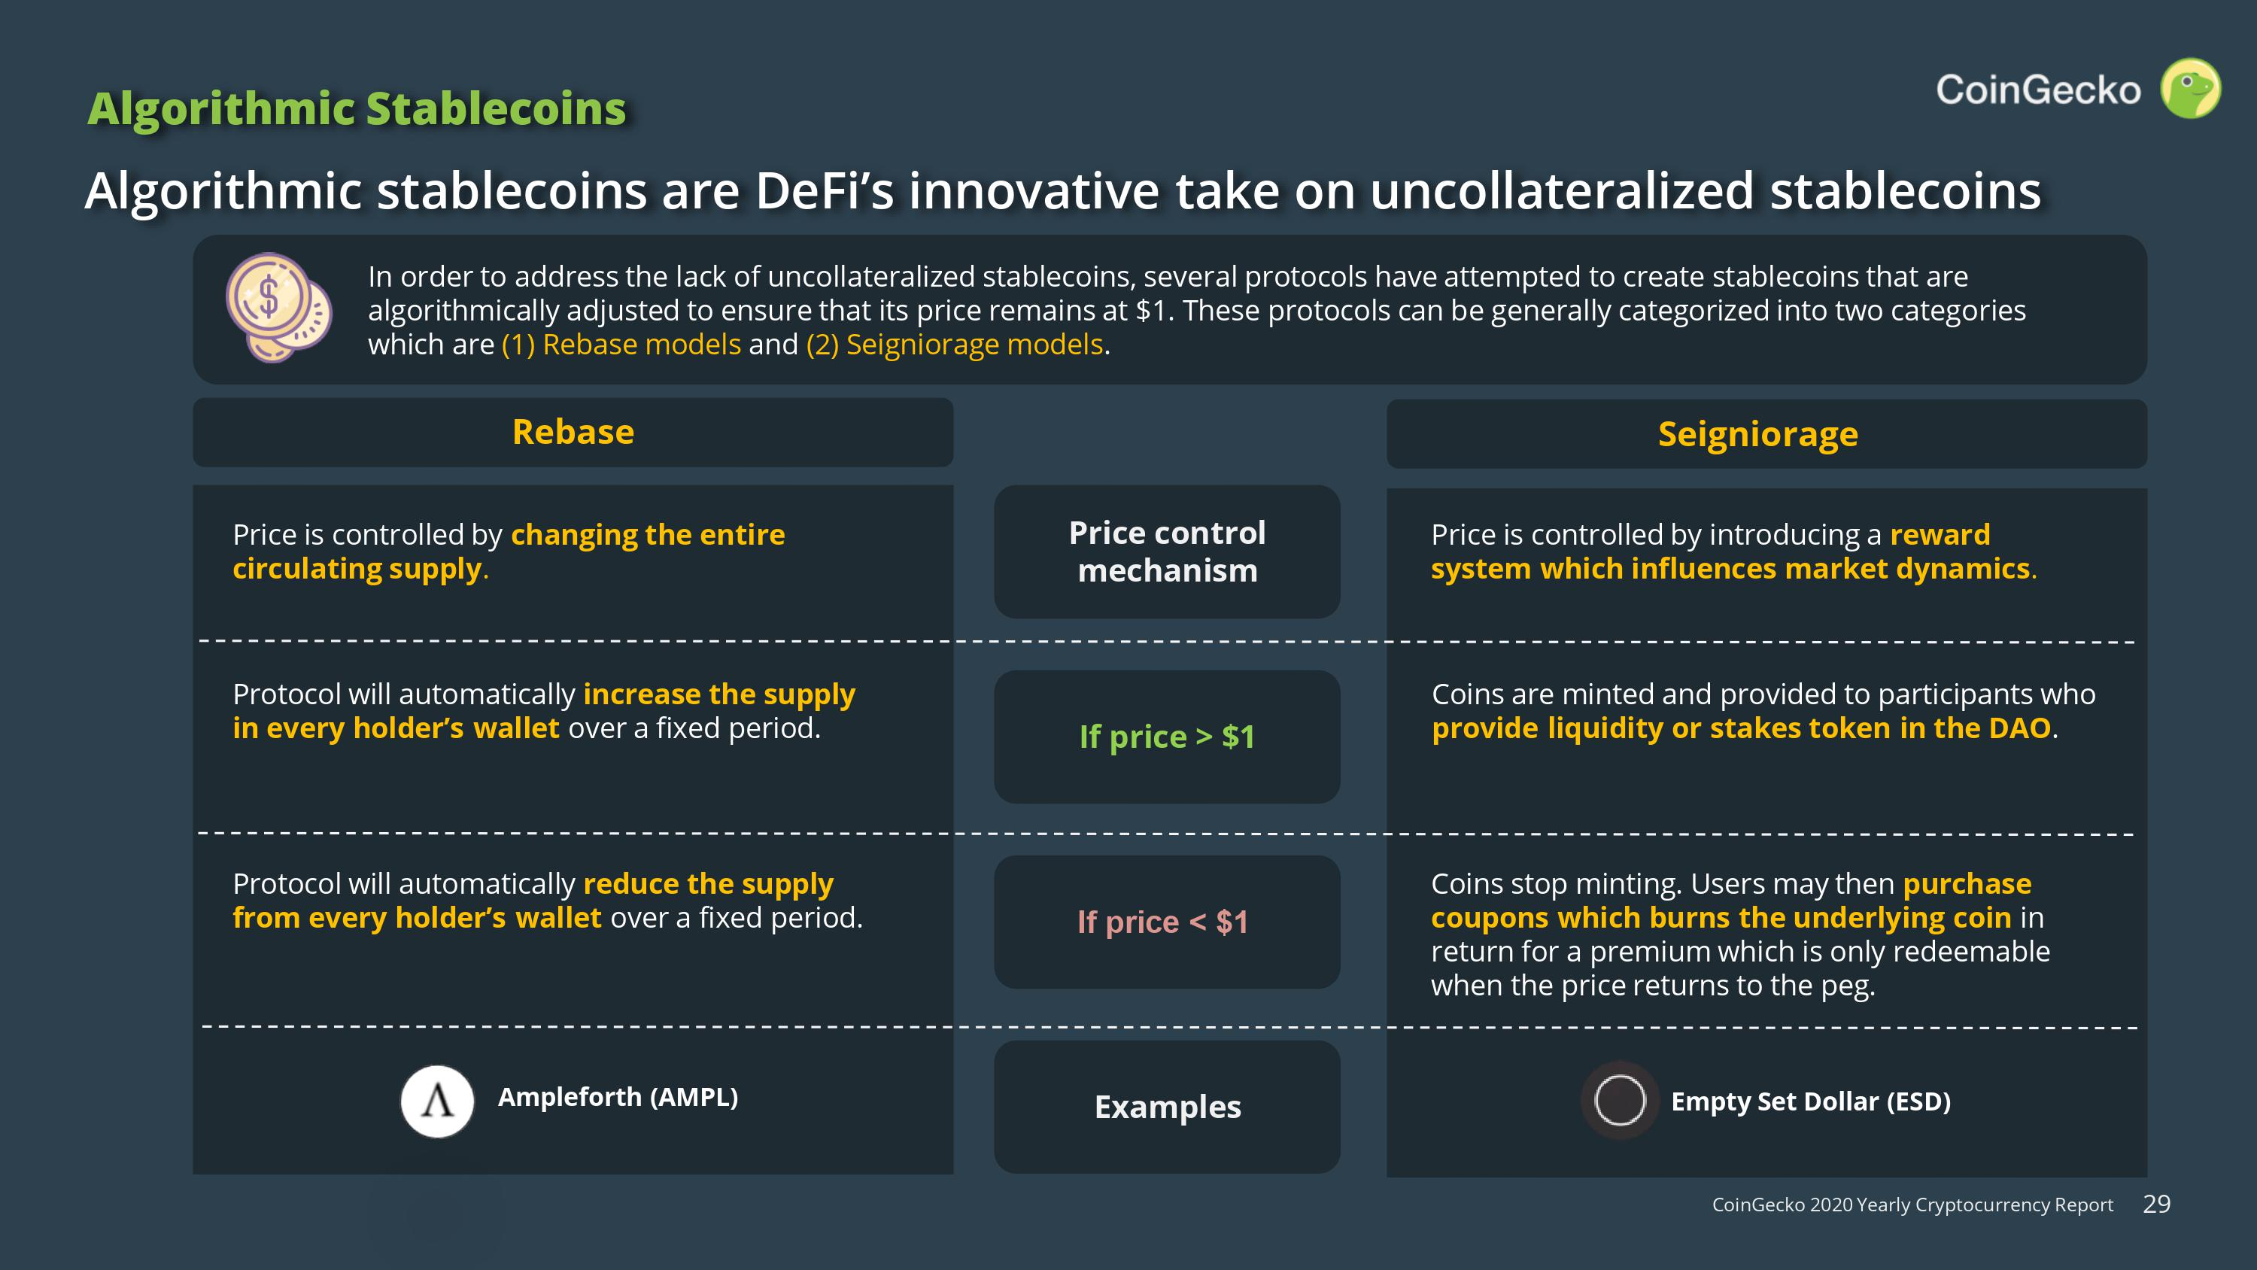

Slide 30
Rebase: Ampleforth
Ampleforth operates a stablecoin called AMPL, and it adjusts the supply of AMPL managed by the software daily to maintain price parity with the U.S. dollar.
In practice, this means that anyone who owns AMPL tokens will see the balance in their wallets change each day at 2:00 UTC. In order to adjust the AMPL supply correctly, the protocol must know the price of AMPL and whether it has diverged from the U.S. dollar.
The Ampleforth software uses Chainlink, a data provider built on Ethereum to supply price data.
As a result of AMPL’s design, the supply of coins will exist in three states:
Expansion – The price of AMPL is greater than $1, and thus new tokens need to be introduced to the AMPL economy.
Contraction – The price of AMPLE is less than $1, leading to the removal of tokens.
Equilibrium – The price of 1 AMPL is exactly $1

Slide 31
Seignorage - Dual Token: Basic Cash
Seignorage is the term to describe the profit that banks make between printing money and what the money is actually worth. So a dollar might cost $.03 to print, but be worth $1… which means the seignorage is 97 cents.
Basis Cash keeps it peg because there are 2 total coins (plus a bond) for this process to work. When the price of Basis Cash is over $1, they do the simplest thing possible to push the price back down to $1: print more. But where do they give that extra money to? Well, if you own yourself some Basis Shares, which is the second coin in this stablecoin-trio, you get a portion of all those free Basic Cash tokens newly minted from the money printer.
What about when the price falls below $1? People can buy Basis Bonds. Traders spend their Basis Cash to buy Basis Bonds, so that the price of Basis Cash goes back up, since there are less tokens in the market. They are incentivized to do this since the next time the price goes above a dollar, the Basis Bond holders get paid first, then the Basis Share holders do.

Slide 32
Seignorage - Single Token: Empty Set Dollar
You only have the stable coin and the bond
If ESD price goes under $1, holders can purchase coupons, which are sold at a discount and their purpose is to get rid of ESD in the system… effectively burning them and raising the price again.
Coupons are only redeemable if the price goes above $1, and only for a short period of time, so there is a little bit of a difference compared to the Basis Cash.

Slide 33
Seignorage - Dual Token – without bonds
TerraUSD (also known as UST) and Luna are two sister coins on the same network.
Terra is a blockchain network, similar to Ethereum or Bitcoin, that produces Luna tokens. The network was created in 2018 by Do Kwon and Daniel Shin of Terraform Labs.
Luna was Terra’s blockchain native token, similar to how ether is used on the Ethereum network. Luna had four different roles in the Terra network:
A method to pay for transaction fees in the Terra network.
A mechanism for maintaining Terra’s stablecoin peg.
Staking in Terra’s delegated proof of stake (DPoS) to validate network transactions.
Participation in the platform’s governance by adding to and voting on proposals when it comes to changes in the Terra network.
To create UST you have to burn Luna. So, for example, when Luna token's price was $85, you could trade one token for 85 UST. This deflationary protocol was designed to ensure there was long-term growth for Luna.
For UST to retain its peg, one UST could be changed for $1 worth of Luna at any time. If UST slipped, traders could make money from buying UST and then exchanging it for Luna.

Slide 34
TerraUSD (also known as UST) and Luna are two sister coins on the same network.
Terra is a blockchain network, similar to Ethereum or Bitcoin, that produces Luna tokens. The network was created in 2018 by Do Kwon and Daniel Shin of Terraform Labs.
Luna was Terra’s blockchain native token, similar to how ether is used on the Ethereum network. Luna had four different roles in the Terra network:
A method to pay for transaction fees in the Terra network.
A mechanism for maintaining Terra’s stablecoin peg.
Staking in Terra’s delegated proof of stake (DPoS) to validate network transactions.
Participation in the platform’s governance by adding to and voting on proposals when it comes to changes in the Terra network.
To create UST you have to burn Luna. So, for example, when Luna token's price was $85, you could trade one token for 85 UST. This deflationary protocol was designed to ensure there was long-term growth for Luna.
For UST to retain its peg, one UST could be changed for $1 worth of Luna at any time. If UST slipped, traders could make money from buying UST and then exchanging it for Luna.

Slide 35
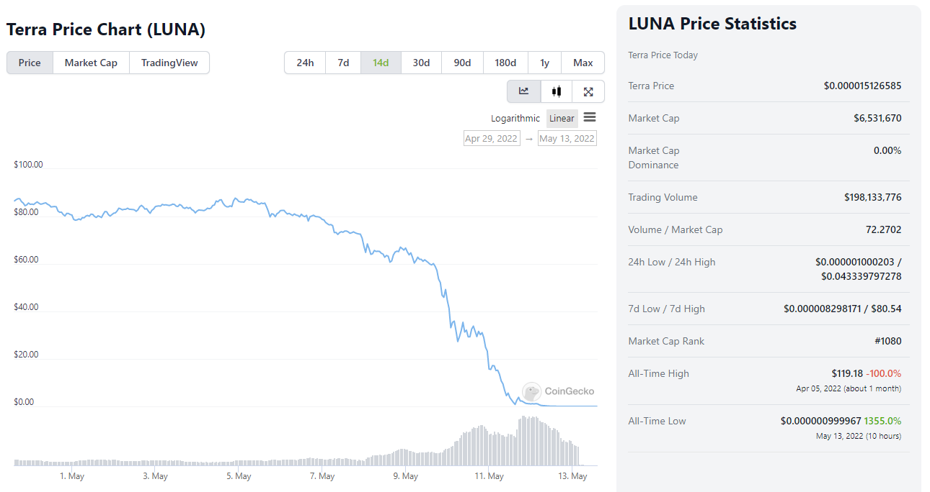

Slide 36
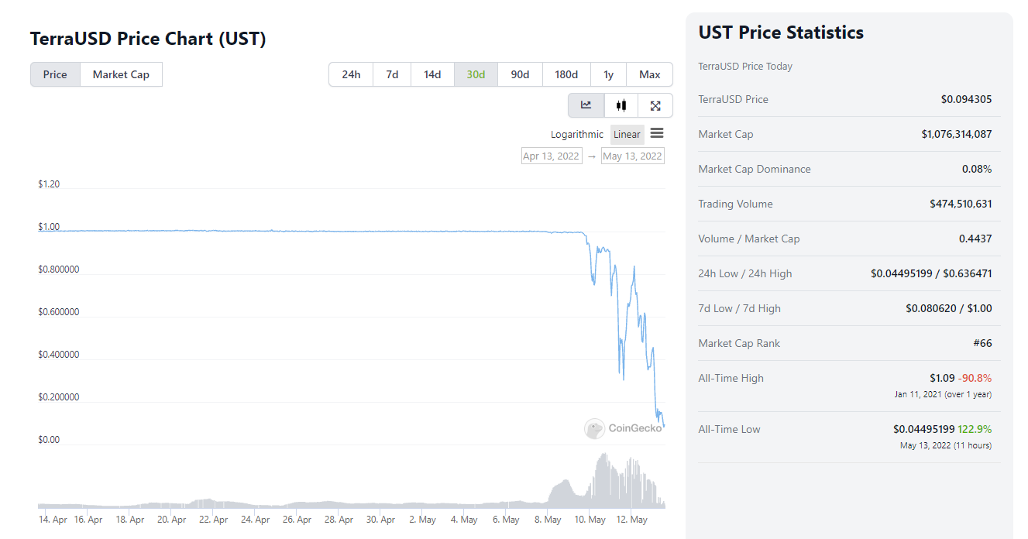

Slide 37
On May 7, 2022, over $2 billion worth of UST was unstaked (taken off the Anchor Protocol), and hundreds of millions of it were quickly liquidated.
There’s debate as to whether this happened as a response to rising interest rates or if it was a malicious attack on the Terra blockchain. (see next slide)
The huge sell-offs brought down the price of UST to $0.91, from $1. As a result, traders started to change 90 cents worth of UST for $1 of Luna.
Once a large amount of UST had been offloaded, the stablecoin started to depeg.
In a panic, more people sold off UST, which led to the minting of more Luna and an increase in the circulating supply of Luna.

Slide 38
Anchor Protocol consisted of a platform that allowed users to deposit their TerraUSD (UST) stablecoins, lock the amount, and receive 20% annual interest.
When it was released, many were suspicious of such a high profit, considered impossible to maintain in the long run, and in fact it caused the collapse of the entire Terra(Luna) ecosystem.
In fact, the majority of UST investors bought the tokens only for the purpose of profitable deposit.
At the beginning of May 2023, suddenly, almost the entire capital of UST deposited on Anchor was withdrawn from the platform and liquidated causing everything to collapse.
Also because the Terra blockchain was based on keeping the supplies of UST and LUNA tokens in balance.

Slide 39
LIBRA
https://libra.org/en-US/
https://libra.org/en-US/wp-content/uploads/sites/23/2019/06/LibraWhitePaper_en_US.pdf

Slide 40
Morgan Beller planted the first seeds of Libra, she is known as the key figure behind Facebook's push into blockchain technology; she also considers herself a co-creator of Libra. After she joined Facebook in 2017, she spent over a year and a half working on blockchain strategy before becoming the head of strategy for Calibra, a digital wallet for Libra built on blockchain technology.
May 2017: Morgan Bellerleft her job at Medium.com and started working at Facebook. Nine months later, she joined the blockchain strategy team and started working on Facebook blockchain initiative.
8 May 2018: David Marcus (Facebook vice president) joined the new Libra team and officially began working on the new project. They recruited other top Facebook talent onto the new blockchain division.
13 June 2019: The Wall Street Journal reported that Facebook is working on its own cryptocurrency that will be announced next week, and set to be launched next year alongside the blockchain-based network that will support it. The Wall Street Journal also reported that Facebook has secured backing from more than a dozen companies like PayPal, Visa, Mastercard, Stripe, Booking.com, and each company will invest around $10 million to fund the new currency development.

Slide 41
18 June 2019: Facebook announced Libra digital currency, Calibra digital wallet, and the nonprofit Libra Association, an organization based in Geneva, Switzerland, that will govern the new currency.
16 July 2019: David Marcus told the Senate Banking Committee in U.S. Senate Hearing, "that Facebook will only build its own Calibra cryptocurrency wallet into Messenger and WhatsApp, and will refuse to embed competing wallets" and also expressed that "Libra will not launch until the U.S. lawmakers' concerns have been answered".
4 October 2019: PayPal withdraws from the Libra Association.
9 October 2019: U.S. Senator Sherrod Brown and Senator Brian Schatz sent letters to the CEOs of Stripe, Visa, and MasterCard to express deep concerns over Facebook's Libra Association
11 October 2019: eBay, Mastercard, Strip, Visa, and Mercado Pago withdraw from the Libra Association.
15 October 2019: Facebook launches Libra Association. Representatives from the remaining 21 organizations (out of 28 original members) met and signed Libra Association charter in Geneva. 21 initial members include: Coinbase, Lyft, Uber Technologies, Spotify AB, PayU, Vodafone, Women's World Banking, Mercy Corps, Creative Destruction Lab any other organizations
Source: https://www.publish0x.com/crypto-timelines/a-brief-timeline-of-libra-xqqdww

Slide 42
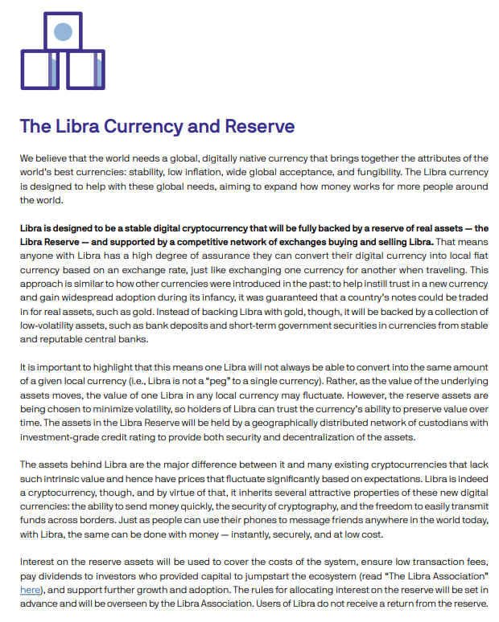
Going through the whitepaper…

Slide 43
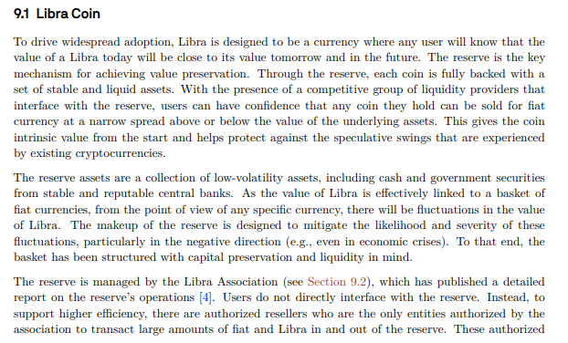
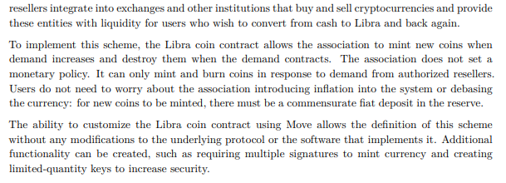
Going through the technical paper…

Slide 44
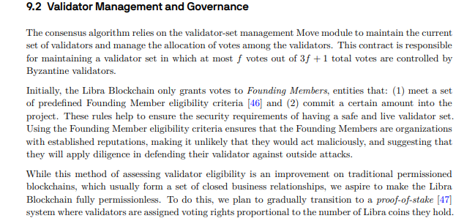
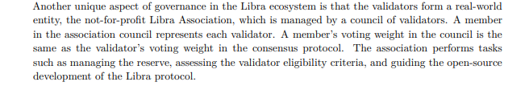
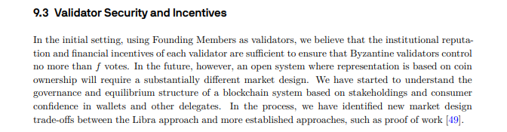

Slide 45
Nov 2020: Libra will start in January 2021
Facebook is scaling back its ambitious plan to upend the global financial system with a new digital currency.
Succumbing to pressure from regulators, Facebook has decided to offer its users digital versions of government-backed currencies, including the U.S. dollar and the euro, in addition to the proposed Libra token, according to three people familiar with the matter. Facebook still plans to go ahead with the launch of a digital wallet that would allow users to make purchases and send and receive money, though it will delay the rollout by several months.
Source: https://www.theinformation.com/articles/facebook-scales-back-libra-plans-bowing-to-regulators
2021: From Libra to Diem
2022: Carpe Diem

